Slide 1


FIBRE`S IN CONCRETE
Mr. Y. S. Lanjewar
Assistant Professor
St. VINCENT PALLOTTI COLLEGE OF ENGINEERING &
TECHNOLOGY,NAGPUR
DEPARTMENT OF CIVIL ENGINEERING

Slide 2
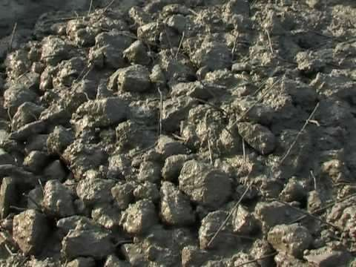
Content
Fibre`s
History of Fibre
Why fibre`s are used?
Type`s of Fibre
Application of fibre
Advantage and Disadvantage
Fibre`s
Fibre`s

Slide 3
What is fibre?
Fibre is a small piece of reinforcing material which increases the structural integrity of concrete.
These short discrete fibers that are uniformly distributed and randomly oriented provide strength and toughness.

Slide 4
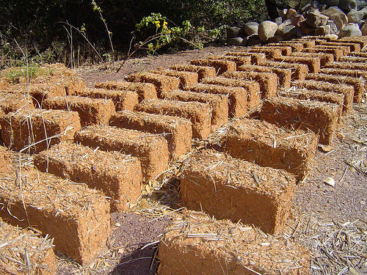
History of Fibre
The use of fibers goes back at least 3500 years, when straw was used to reinforce sun-baked bricks in Mesopotamia.
Horsehair was used in mortar and straw in mud bricks.
Abestos fibers were used in concrete in the early 1900

Slide 5
History continues.....
In the 1950s, the concept of composite materials came into picture.
Steel , Glass and synthetic fibers have been used to improve the properties of concrete for the past 30 or 40 years.
Research into new fiber-reinforced concretes continues even today .

Slide 6
Fibre Reinforced Concrete
Concrete containing cement, water , aggregate, and discontinuous, uniformly dispersed or discrete fibers is called fiber reinforced concrete.
It is a composite obtained by adding a single type or a blend of fibers to the conventional concrete mix.
Fibers can be in form of steel fibers, glass fibers, natural
fibers , synthetic fibers, etc.

Slide 7
Why Fibres are used?
Main role of fibers is to bridge the cracks that develop in concrete and increase the ductility of concrete elements.
There is considerable improvement in the post-cracking behavior of concrete containing fibers due to both plastic shrinkage and drying shrinkage.
They also reduce the permeability of concrete and thus reduce bleeding of water.

Slide 8
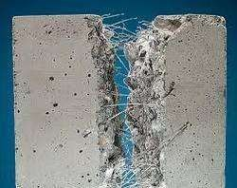
Some types of fibers produce greater abrasion and shatter
resistance in concrete.
Imparts more resistance to Impact load.
Fibre

Slide 9
Toughness
Toughness is ability of a material to absorb energy and plastically deform without fracturing.
It can also be defined as resistance t o fracture of a material when stressed.

Slide 10
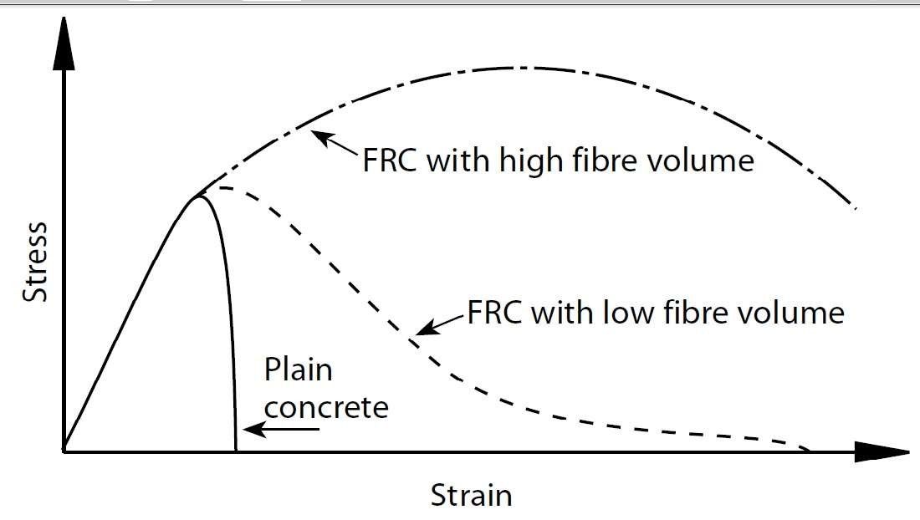
Contd.
The above graph shows the stress-strain relation between FRC and Plain concrete.

Slide 11
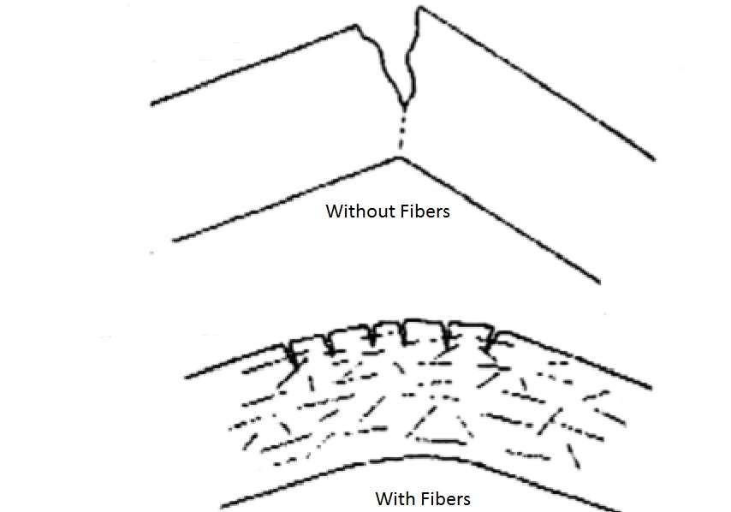
Contd.
Variation of crack and fracture resistance between FRC and plain concrete.

Slide 12
Types of Fibre
Steel Fibre Reinforced Concrete(SFRC)
Glass Fibre Reinforced Concrete(GFRC)
Asbestos Fibres
Synthetic Fibres
Natural Fibres
Carbon and Cellulose Fibres

Slide 13

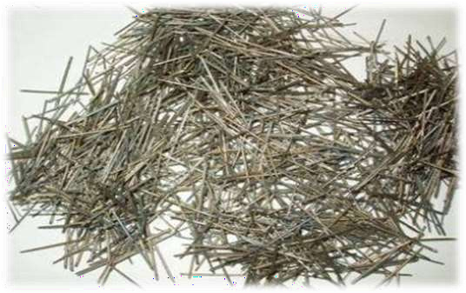
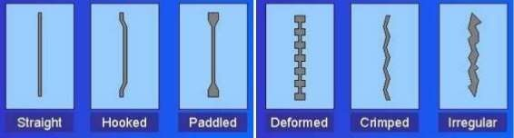

Slide 14
Steel fibres have an aspect ratios of 30 to 250. Diameters vary from 0.25 mm to 0.75 mm.
High structural strength.
Control crack widths tightly, thus improving durability.
Used in pre-cast and structural applications, highway and airport pavements, canal linings, industrial flooring, bridge decks, etc.

Slide 15


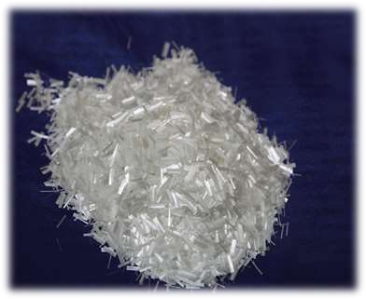
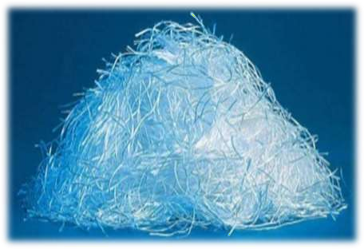

Slide 16
High tensile strength, 1020 to 4080 N/mm^2. Generally, fibres of length 25 mm are used.
Improvement in impact strength.
Increase in flexural strength, ductility, and resistance to thermal shock.
Used in formwork, swimming pools, sewers linings, etc.

Slide 17


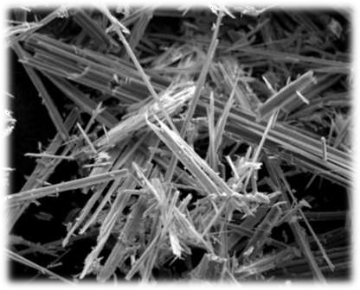
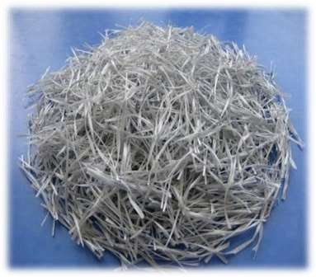

Slide 18
Tensile strength varies from 560 to 980 N/mm^2. Higher flexural strength and low impact strength. Thermal, Mechanical & Chemical resistant.
Suitable for sheet product pipes, tiles and corrugated roofing elements.

Slide 19


Man-made fibres from petrochemicals and textile industries.
Cheap and abundantly available.
High chemical resistance. High melting point.
Types: Acrylic, Aramid, Polyester, Polythene, Polyproplene, Nylon, etc.

Slide 20



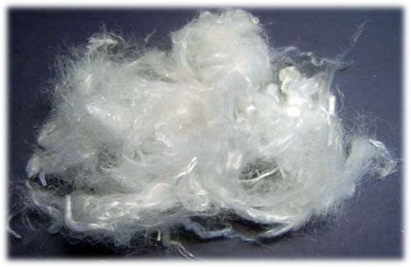
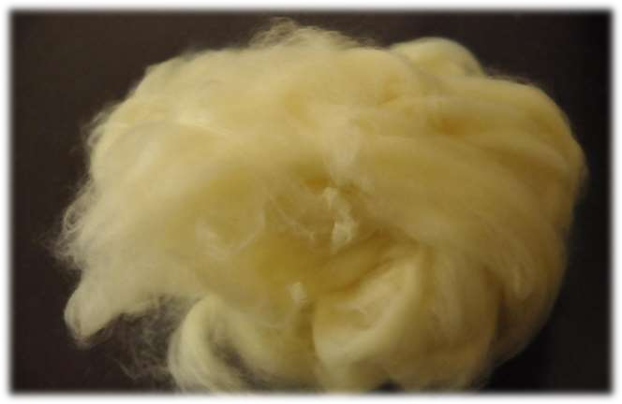

Slide 21


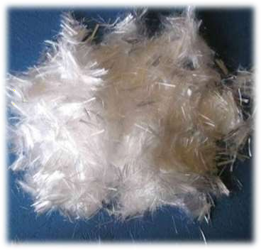
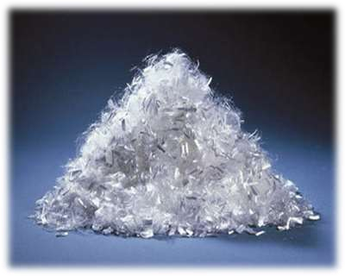

Slide 22

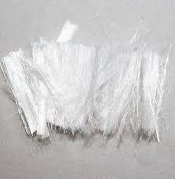
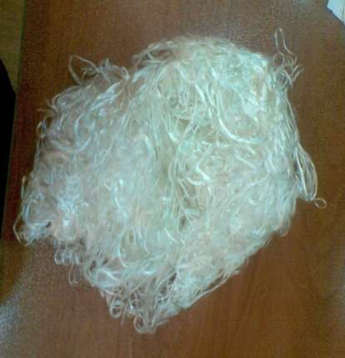

Slide 23

Increase resistance to plastic shrinkage during curing.
Improve structural strength.
Improve ductility.
Reduce steel reinforcement requirements.
Improve impact resistance and abrasion resistance.

Slide 24
Improves ductility. Improve freeze-thaw effect.
Reduce crack widths and control the crack widths tightly, thus improving durability.
Improve mix cohesion, improving pump ability over long distances

Slide 25
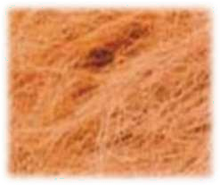
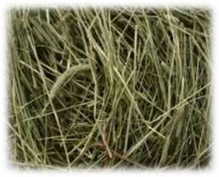


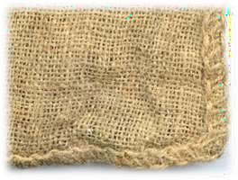
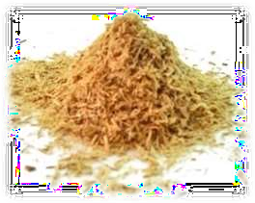

Slide 26
Advantages of FRC
High modulus of elasticity for effective long-term reinforcement, even in the hardened concrete.
Does not rust nor corrode and requires no minimum cover.
Ideal aspect ratio (i.e. relationship between Fiber diameter and length) which makes them excellent for early-age performance.
Easily placed, Cast, Sprayed and less labour intensive than placing rebar.

Slide 27
Continues...
Greater retained toughness in conventional concrete mixes.
Higher flexural strength, depending on addition rate.
Can be made into thin sheets or irregular shapes.
FRC possesses enough plasticity to go under large deformation once the peak load has been reached.

Slide 28
Disadvantages of FRC
Greater reduction of workability.
High cost of materials.
Generally fibers do not increase the flexural strength of concrete, and so cannot replace moment resisting or structural steel reinforcement.

Slide 29


